Slide 1
Regular grammars
Programming Language Design and Implementation (4th Edition)
by T. Pratt and M. Zelkowitz
Prentice Hall, 2001
Section 3.3.2

Slide 2
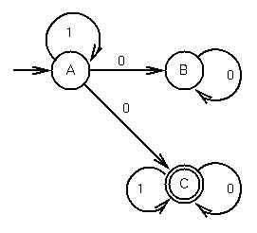
Finite state automaton
A finite state automaton (FSA) is a graph with directed labeled arcs, two types of nodes (final and non-final state), and a unique start state:
This is also called a
state machine.
What strings, starting in
state A, end up at state C?
The language accepted by machine M is set of strings that move from start node to a final node, or more formally: T(M) = {ω | δ(A,ω) = C} where A is start node and C a final node.

Slide 3
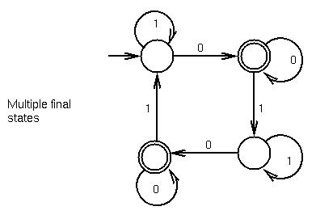
More on FSAs
An FSA can have more than one final state:

Slide 4
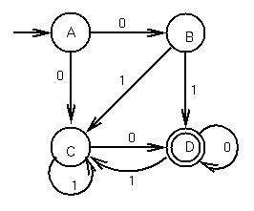
Deterministic FSAs
Deterministic FSA: For each state and for each member of the alphabet, there is exactly one transition.
Non-deterministic FSA (NDFSA): Remove restriction.
At each node there is 0, 1, or more than one transition for each alphabet symbol.
A string is accepted if there is some path from the start state to some final state.
Example nondeterministic FSA (NDFSA):
01 is accepted via path:
ABD
even though 01 also can
take the paths:
ACC or ABC
and C is not a final state.

Slide 5
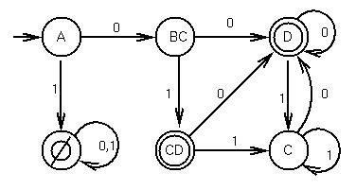
Equivalence of FSA and NDFSA
Important early result:
NDFSA = DFSA
Let subsets of states be
states in DFSA.
Keep track of which subset
you can be in.
Any string from {A} to
either {D} or {CD}
represents a path from
A to D in the original
NDFSA.

Slide 6
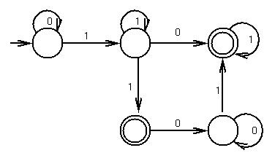
Regular expressions
Can write regular language as an expression:
0*11*(0|100*1)1*|0*11*1
Operators:
Concatenation (adjacency)
Or (| or sometime written as ∨)
Kleene closure (* - 0 or more instances)

Slide 7
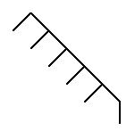
Regular grammars
A regular grammar is a context free
grammar where every production is of
one of the two forms:
    X → aY
    X → a
for X, Y  N, a  T
Theorem: L(G) for regular grammar G is equivalent to T(M) for FSA M.
The proof is “constructive.” That is given either G or M, can construct the other. [Next slide]

Slide 8
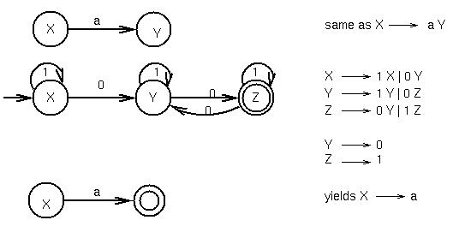
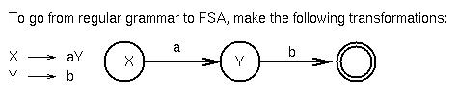
Equivalence of FSA and regular grammars

Slide 9
Extended BNF
This is a shorthand notation for BNF rules. It adds no power to the syntax,only a shorthand way to write productions:
| - Choice
( ) - Grouping
{}* - Repetition - 0 or more
{}+ - Repetition - 1 or more
[ ] - Optional
Example: Identifier - a letter followed by 0 or more letters or digits:
Extended BNF Regular BNF
I → L { L | D }* I → L | L M
L → a | b |... M → CM | C
D → 0 | 1 |... C → L | D
L → a | b |...
D → 0 | 1 |...

Slide 10
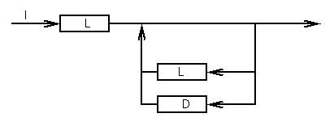
Syntax diagrams
Also called railroad charts since they look like railroad switching yards.
Trace a path through network: An L followed by repeated
loops through L and D, i.e., extended BNF:
L → L (L | D)*

Slide 11
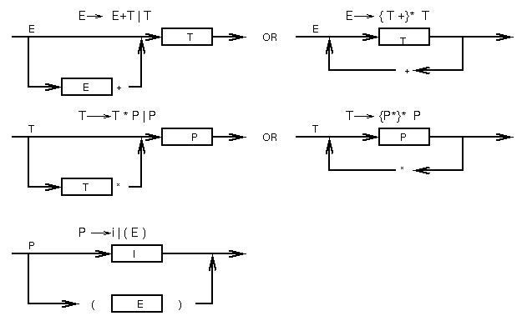
Syntax charts for expression grammar

Slide 12
Why do we care about regular languages?
Programs are composed of tokens:
Identifier
Number
Keyword
Special symbols
Each of these can be defined by regular grammars. (See next slide.)
Problem: How do we handle multiple symbol operators (e.g., ++ in C, =+ in C, := in Pascal)?
?? -multiple final states?

Slide 13
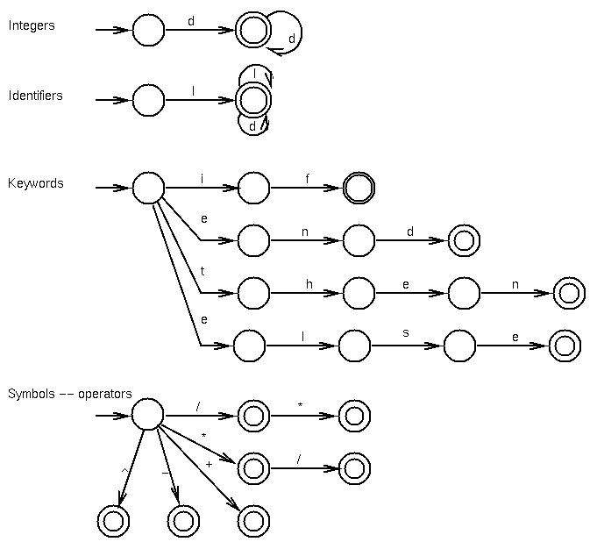
Sample token classes

Slide 14
FSA summary
Scanner for a language turns out to be a giant NDFSA for grammar.(i.e., have λ-rules going from start state to the start state of each token-type on previous slide).
integer
λ
λ
identifier
λ
keyword
λ
symbol

